Slide 1




LENDI INSTITUTE OF ENGINEERING AND TECHNOLGOY
(Autonomous)
Approved by AICTE and Permanently affiliated to JNTU Gurajada-Vizianagaram.
ECE,EEE,CSE&MECH
DEPARTMENT OF COMPUTER SCIENCE AND ENGINEERING
NAME OF THE SUBJECT :
NAME OF THE TOPIC :
PRESENTED BY :
Mr. N P PATNAIK M
Assistant Professor

Slide 2
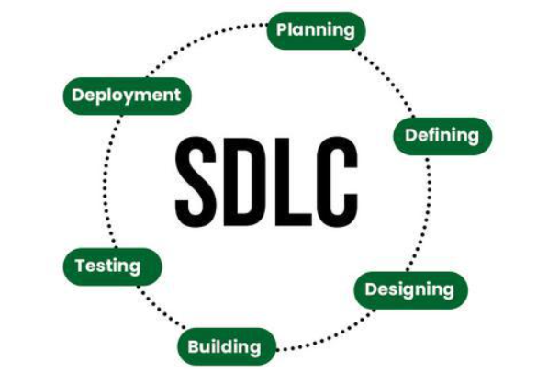
Software Development Life Cycle (SDLC)

Slide 3
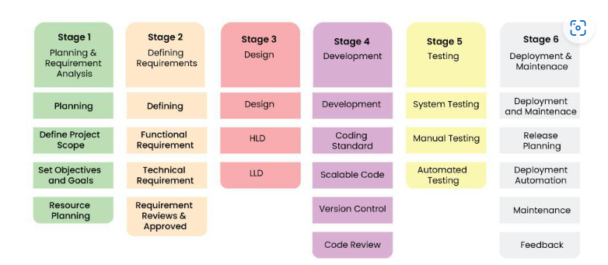
Stages of the Software Development Life Cycle

Slide 4
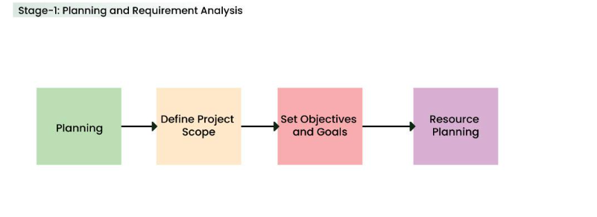
Stage-1: Planning and Requirement Analysis

Slide 5
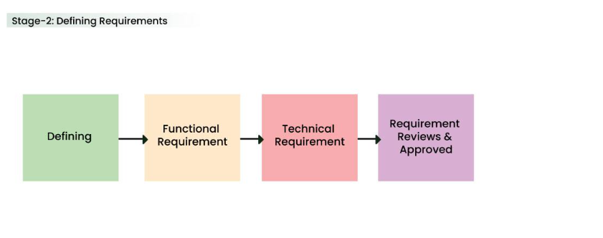
Stage-2: Defining Requirements

Slide 6
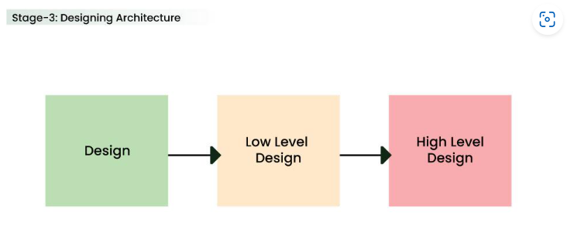
Stage-3: Designing Architecture

Slide 7
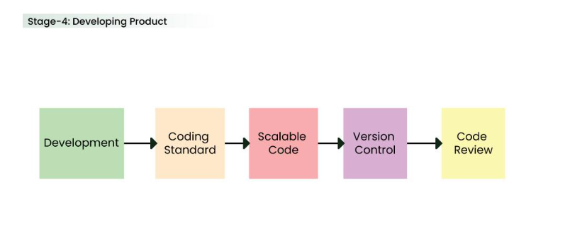
Stage-4: Developing Product

Slide 8
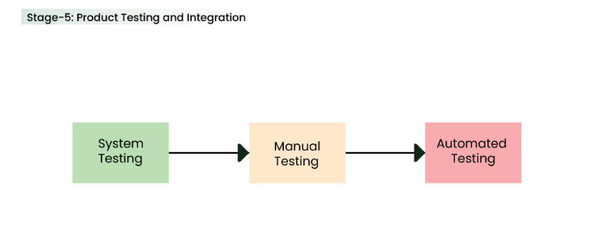
Stage-5: Product Testing and Integration

Slide 9
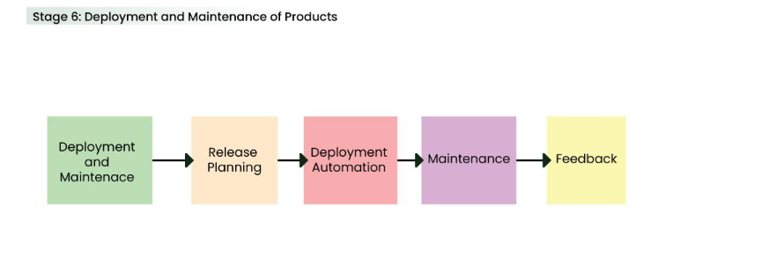
Stage-6: Deployment and Maintenance of Products

